Slide 1
Capstone Group Project
Presenting to the Unicorn CEOs

Slide 2
Presenting the team
(In no particular order)
Suna Jayyousi, 25 from Jerusalem, an industrial engineer studying to be a data analyst
Jazmin Blank, 33 from Modiin, a special education teacher studying to be a data analyst
Naama Levy, 22 from Haifa ,Released from the army where she served as commander of a weather forecasting course , studying to be a data analyst
Rivit Antin, 45 from Tel-Aviv, an educational counselor studying to be a data analyst
Oded Zohar, 42 from Ashkelon, temporary work while studying to be a data analyst

Slide 3
Presenting the data set, irregularities and data cleaning steps taken
We checked for duplicates and null values to clean the data. After the data was cleaned, two things caught our eye and we will further explore in our presentation:
Furniture is the least profitable of product categories and we find it interesting to look at the data related to the sale of furniture products to receive more insight .
Looking at the data as a whole, we were surprised to see an increase in loss due to negative profit sales and we wanted to further check why.

Slide 4
Our findings on Furniture Category

Slide 5
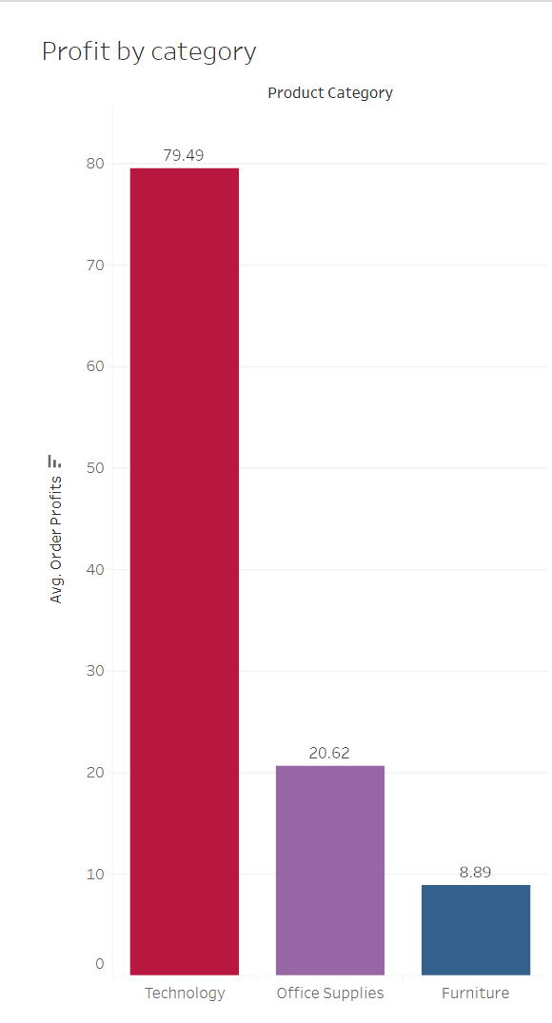

Presenting our narrative
The furniture product category is the least profitable of product categories.

Slide 6
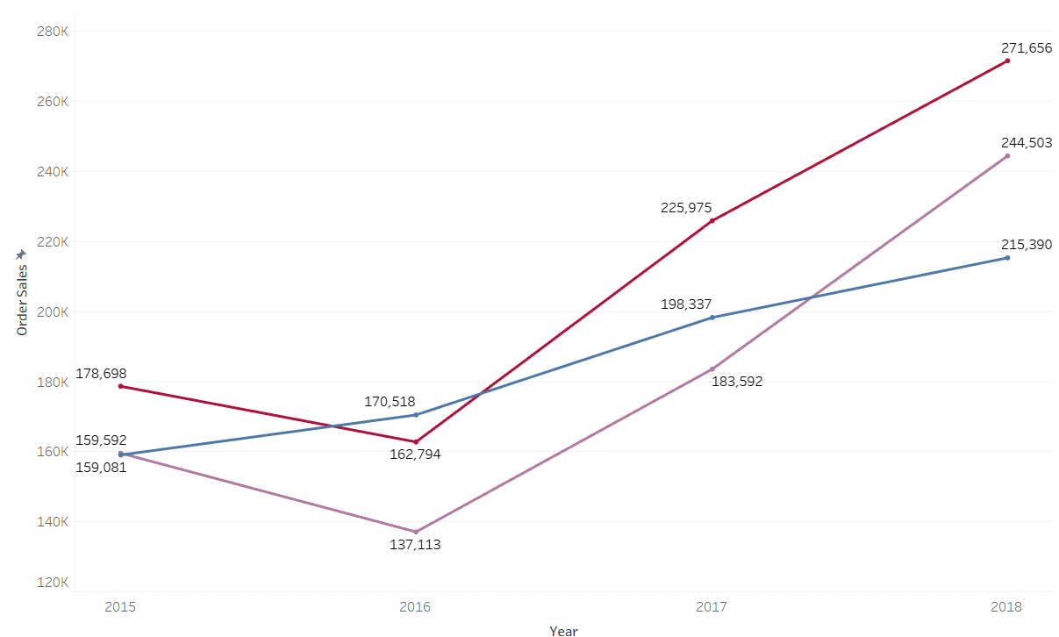
Presenting our narrative
Despite that, the furniture category is not the lowest in orders in most of the years.

Slide 7
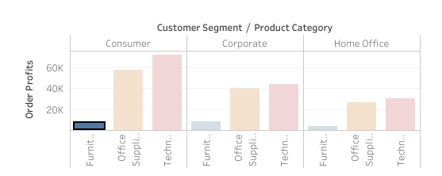
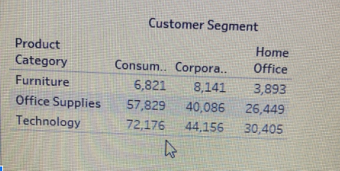
Presenting our narrative
All customer segments (consumer, corporate and home office), spend less on furniture than on other product categories.

Slide 8
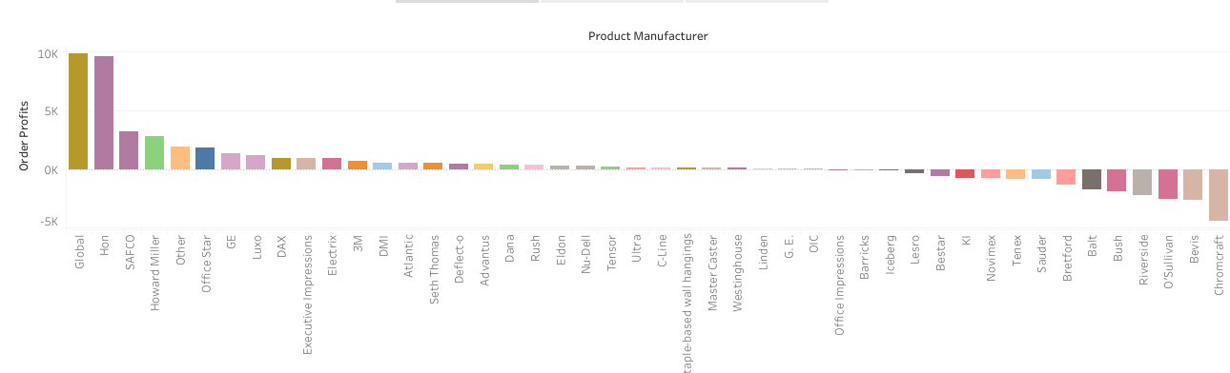
Presenting our narrative
We wanted to look at manufacturers in the furniture category to see which manufacturers were related to loss.

Slide 9
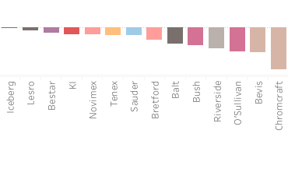
Presenting our narrative
In the furniture category we found 13 manufacturers who generated loss on profit. The least profitable manufacturer is Chromcraft.

Slide 10
To Summarize
We found that the furniture category was the least profitable in all customer segments and all years despite having more sales that other categories in most of the years. We also found that there is a high number of manufacture companies that show losses and we will advice to explore this findings more deeply to understand the causes for that.
Following that we decided to look at orders generating negative profits over the years.

Slide 11
Our findings on orders with negative profit

Slide 12
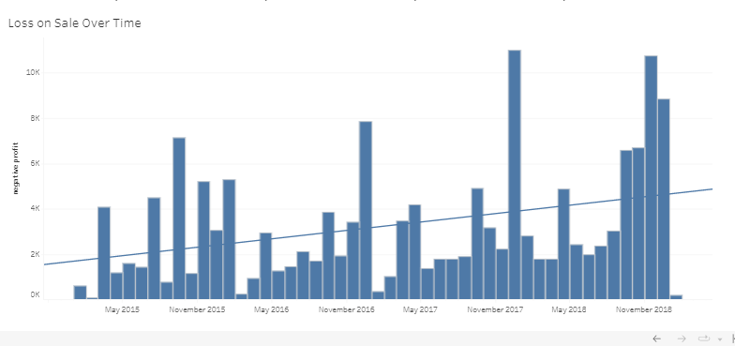
In this chart we can see that there is a rise in the negative profit over time
Presenting our narrative

Slide 13
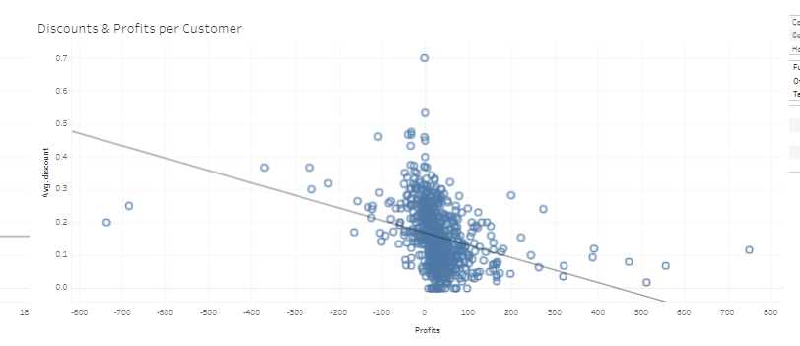
We decided to look for a possible correlation between discounts and profit and we found a negative one.
Presenting our narrative

Slide 14
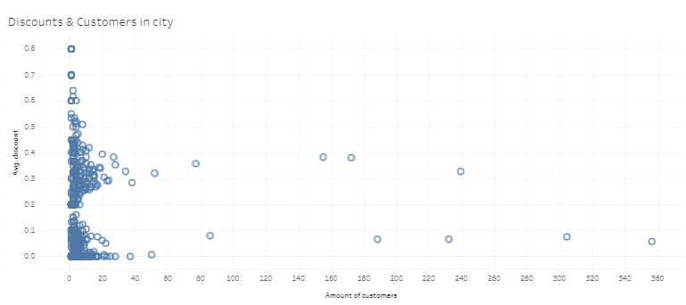
Here we tried to find a link between the discount amount and the number of customers and we found that
giving a high discount doesn’t necessarily bring us more customers.
Presenting our narrative

Slide 15
To Conclude
We found an increase in loss on sales over time, potentially due to large discounts. We also found no correlation between discounts given, the number of orders per customer, their size (quantity), and a negative correlation to profits. It also cannot be linked to an increased number of customers in the same city.

Slide 16
Our recommendations
We will recommend to analyze more deeply why we have a loss of profit in so many manufactures in the furniture category and depending on the conclusion to consider maybe stop working with some of them.
We also recommend never give more than 50% discount to Unicorn’s customers because as we saw on the charts it will not benefit the company.
We will advise also not give more than 20% in most cases and those cases should be selected wisely.
In addition, if not already, we should implement more meaningful KPIs such as life time profit and profit margins.

